Slide 1
Set Definitions and Operations
...
Written by Rachel J. Morris, last updated 10/19/16

Slide 2
Set Definitions and Operations
This Chapter:
Common sets of numbers,
Specifying elements of a set
Specifying subsets of a set
Difference, Intersection, & Union of sets
Venn diagrams
Set-builder notation

Slide 3
Set Definitions and Operations
There are a lot of things to cover for this first chapter! Let’s take it a step at a time...

Slide 4
Common Sets
The set of natural numbers
These are numbers that can answer counting problems.
The set of rational numbers
These are characterized as ratios of integers such as
1/2, -17/4, or 3/1
The set of real numbers
These can be thought of as decimal numbers with possibly unending strings of digits after the decimal point.
The set of integers
Numbers (positive, negative, and zero) without a fractional/decimal portion.

Slide 5
Common Sets
We might also specify these sets with additional attributes:
The set of positive real numbers.
The set of nonnegative real numbers.
The set of positive rationals.
The set of nonnegative rationals.
The set of positive integers.
The set of nonnegative integers, same as

Slide 6
Our Sets
When working through problems, often we will explicitly define the sets that we are working with.
These generally are represented with a capital letter.
A = { 1, 2, 3 } B = { 2, 4, 6, 8 }, ETC.

Slide 7
Universal & Empty Sets
We will also encounter the universal set and the empty set when working with sets.
When defining a problem and specifying sets, we must also include the universal set U, which the other sets are contained within.
If we look at some combinations of sets together, it is possible that the result will be an empty set, which is denoted with

Slide 8
Example...
We have two sets, A = { 1, 2, 3 }, B = { 2, 3, 4 }
Our universal set is U = { 1, 2, 3, 4, 5 }
Which elements do A and B have in common?

Slide 9
Example...
We have two sets, A = { 1, 2, 3 }, B = { 2, 3, 4 }
Our universal set is U = { 1, 2, 3, 4, 5 }
Which elements do A and B have in common?
The set of elements that A and B have in common is
{ 2, 3 }
This is known as the intersection of A and B, denoted as:

Slide 10
Example...
We have two sets, A = { 1, 2, 3 }, B = { 2, 3, 4 }
Our universal set is U = { 1, 2, 3, 4, 5 }
Which elements does A have, that B doesn’t have?
Which elements does B have, that A doesn’t have?

Slide 11
Example...
We have two sets, A = { 1, 2, 3 }, B = { 2, 3, 4 }
Our universal set is U = { 1, 2, 3, 4, 5 }
Which elements does A have, that B doesn’t have?
Which elements does B have, that A doesn’t have?
The difference between A and B is that A has { 1 }
This is known as the difference of A and B, denoted as:
The difference between B and A is that B has { 4 }
This is known as the difference of B and A, denoted as:

Slide 12
Example...
We have two sets, A = { 1, 2, 3 }, B = { 2, 3, 4 }
Our universal set is U = { 1, 2, 3, 4, 5 }
What is the set if we combine all elements of A and B?

Slide 13
Example...
We have two sets, A = { 1, 2, 3 }, B = { 2, 3, 4 }
Our universal set is U = { 1, 2, 3, 4, 5 }
What is the set if we combine all elements of A and B?
Combining A and B gives us { 1, 2, 3, 4 }.
This is known as the union of A and B, denoted as:

Slide 14
Example...
We have two sets, A = { 1, 2, 3 }, B = { 2, 3, 4 }
Our universal set is U = { 1, 2, 3, 4, 5 }
What is the complement of A?
The complement of A would be everything in the Universe that is not in A: { 4, 5 }
This is known as A’s complement, denoted as A-prime:
Note that A’ is equivalent to:

Slide 15
Summary
The intersection of A and B
Elements common to both A and B
The union of A and B
Elements that are either in set A or in set B
The difference of A and B
Elements in A which are not in B
The complement of A
Elements of the universal set U which are not in A

Slide 16




As Venn Diagrams...
Intersection
Union
Difference
Complement

Slide 17
Subsets of a set
A is a subset of B
A is a subset of B if every element in A is also an element in B.
Formally, this means that for every x,
If then
A is equal to B
A is equal to B if they have exactly the same members.
Formally, this means and

Slide 18
Example...
We have the sets,
A = { 1, 2, 3 }, B = { 2, 3, 4 }, C = { 1, 2 }, D = { 3, 4 }
Our universal set is U = { 1, 2, 3, 4, 5 }
Is C a subset of A?
Is C a subset of B?
Is D a subset of A?
Is D a subset of B?

Slide 19
Example...
We have the sets,
A = { 1, 2, 3 }, B = { 2, 3, 4 }, C = { 1, 2 }, D = { 3, 4 }
Our universal set is U = { 1, 2, 3, 4, 5 }
Is C a subset of A?
Is C a subset of B?
Is D a subset of A?
Is D a subset of B?
All elements of C are also in A, so
C contains 1, which is not in B, so
D contains 4, which is not in A, so
All elements of D are also in B, so

Slide 20
Example...
We have the sets,
A = { 1, 2, 3 }, B = { 2, 3, 4 }, C = { 1, 2 }, D = { 3, 4 }
Our universal set is U = { 1, 2, 3, 4, 5 }
If C is a subset of A, is A also a subset of C?

Slide 21
Example...
We have the sets,
A = { 1, 2, 3 }, B = { 2, 3, 4 }, C = { 1, 2 }, D = { 3, 4 }
Our universal set is U = { 1, 2, 3, 4, 5 }
If C is a subset of A, is A also a subset of C?
No, A has 3 in its set, and C does not.
They are only subsets of each other if they are EQUAL.

Slide 22
Set-builder Notation
With sets, often we cannot write out the entire set if the set is something like, “all even numbers”.
Therefore, we use set-builder notation
To define our sets.
There is the property description set-builder notation
And the form description set-builder notation.

Slide 23
Set-builder Notation
Property Description
The set of all even integers:
{ : for some }
We define the set
that x belongs to.
We define the set that y is in as well.
(y must be an integer for the definition of even integer)
We define x as some even number

Slide 24
Set-builder Notation
Form Description
The set of all even integers:
{ : }
We define an even number. [ x = ] 2y
We define the set
that y belongs to.
Note that we don’t even mention x in this form.

Slide 25
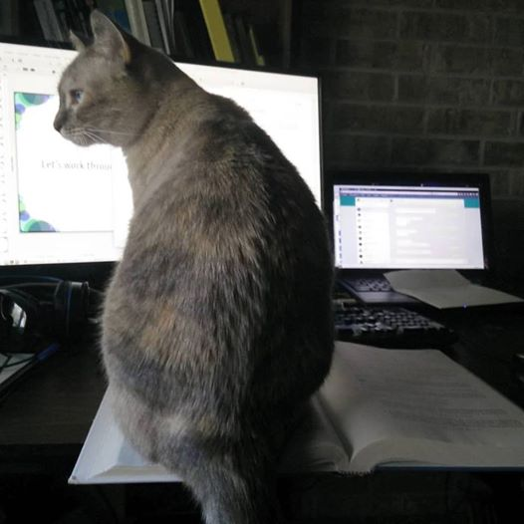
Let’s work through some examples

